Slide 1
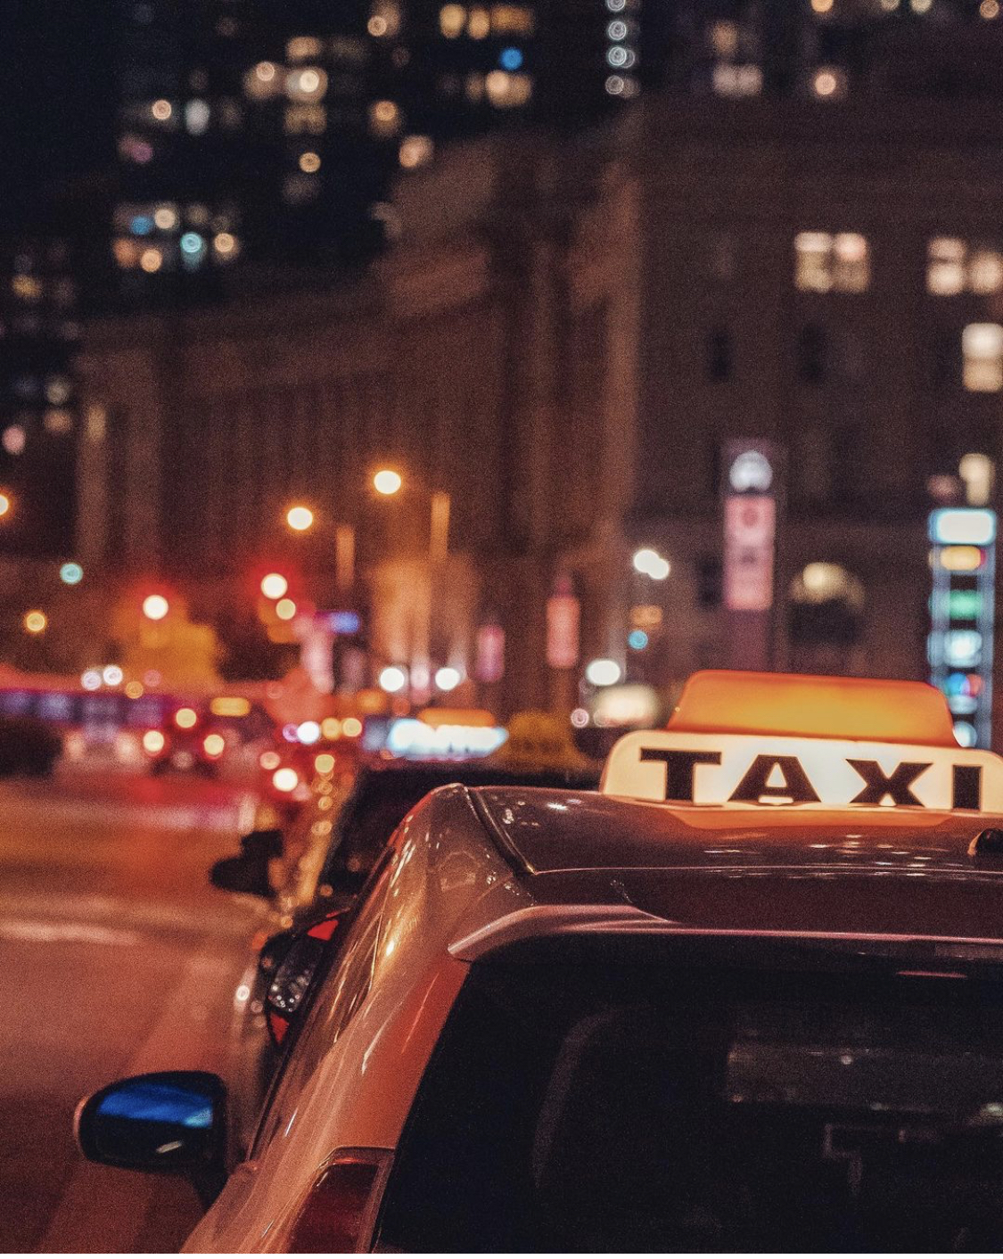
Street life and lights
Bhoomi Panchal
December. 9, 2020

Slide 2
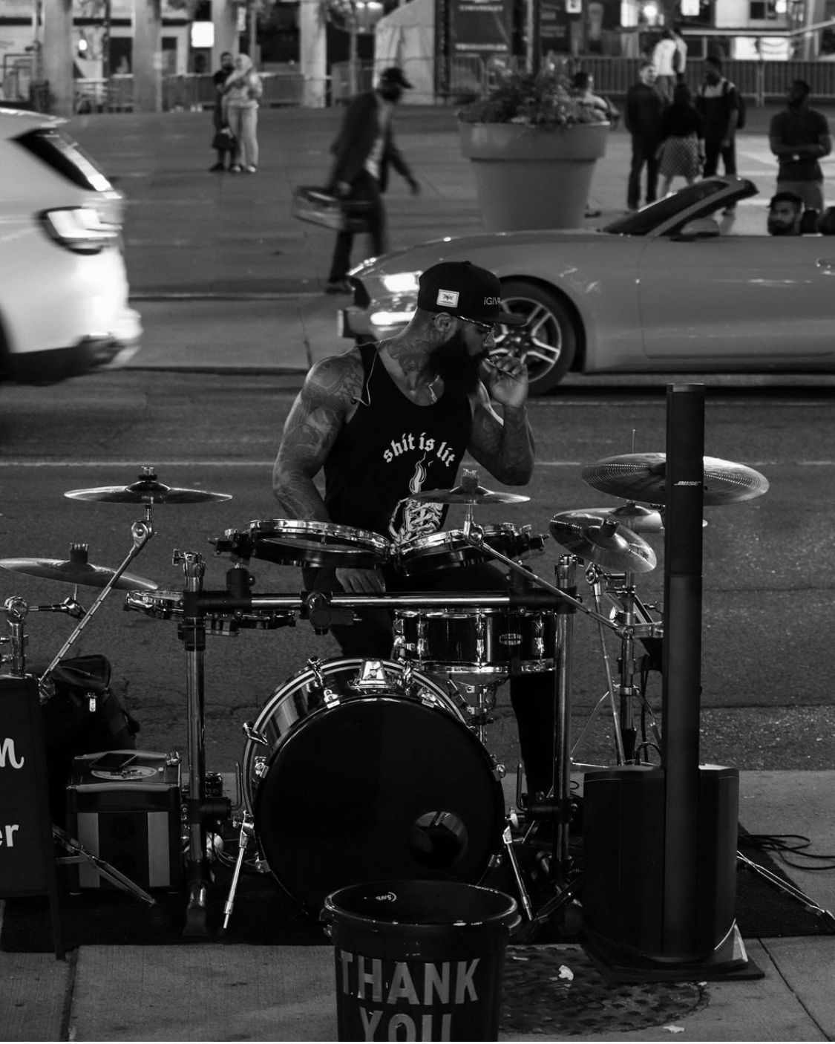

Slide 3
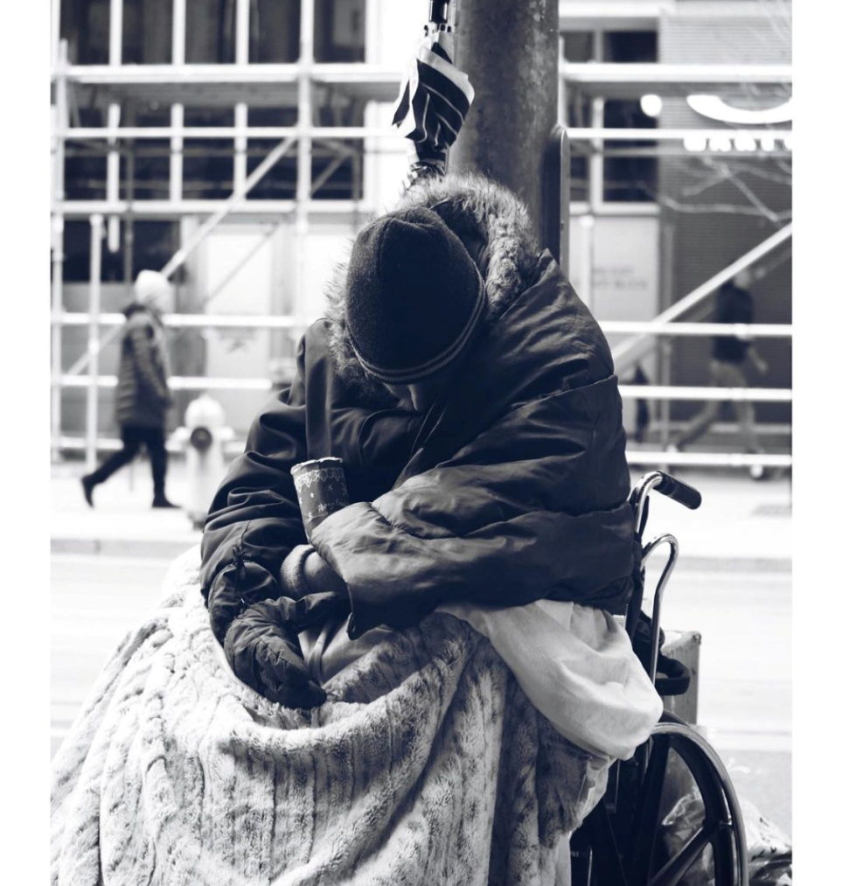
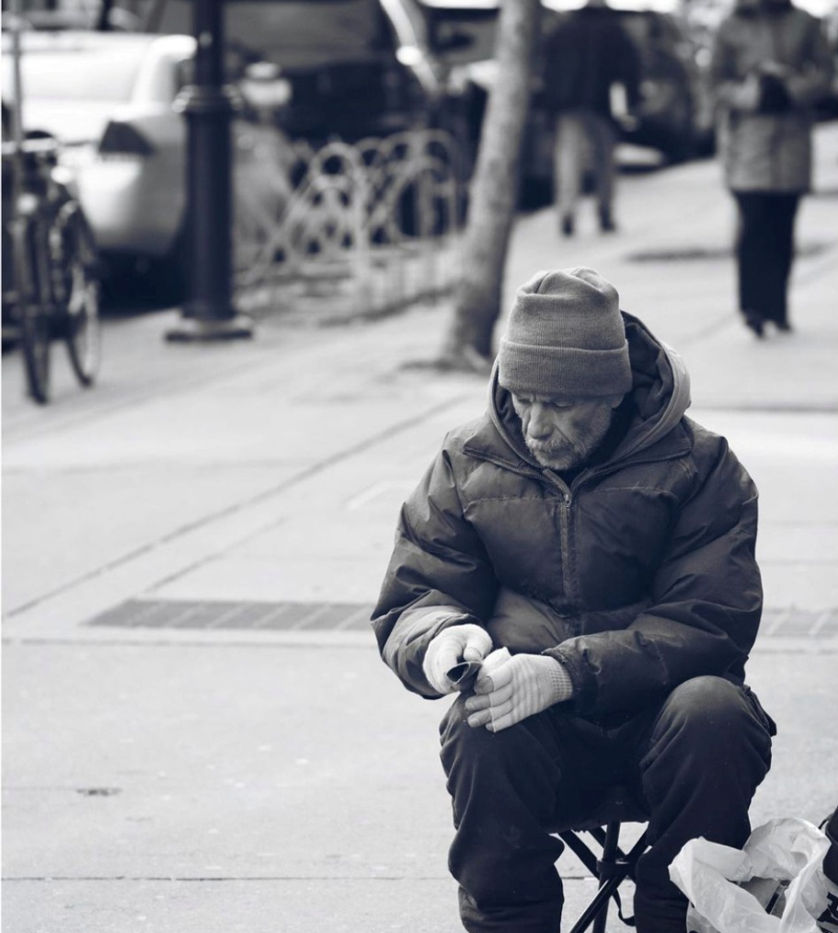
With age, art and life become one.

Slide 4
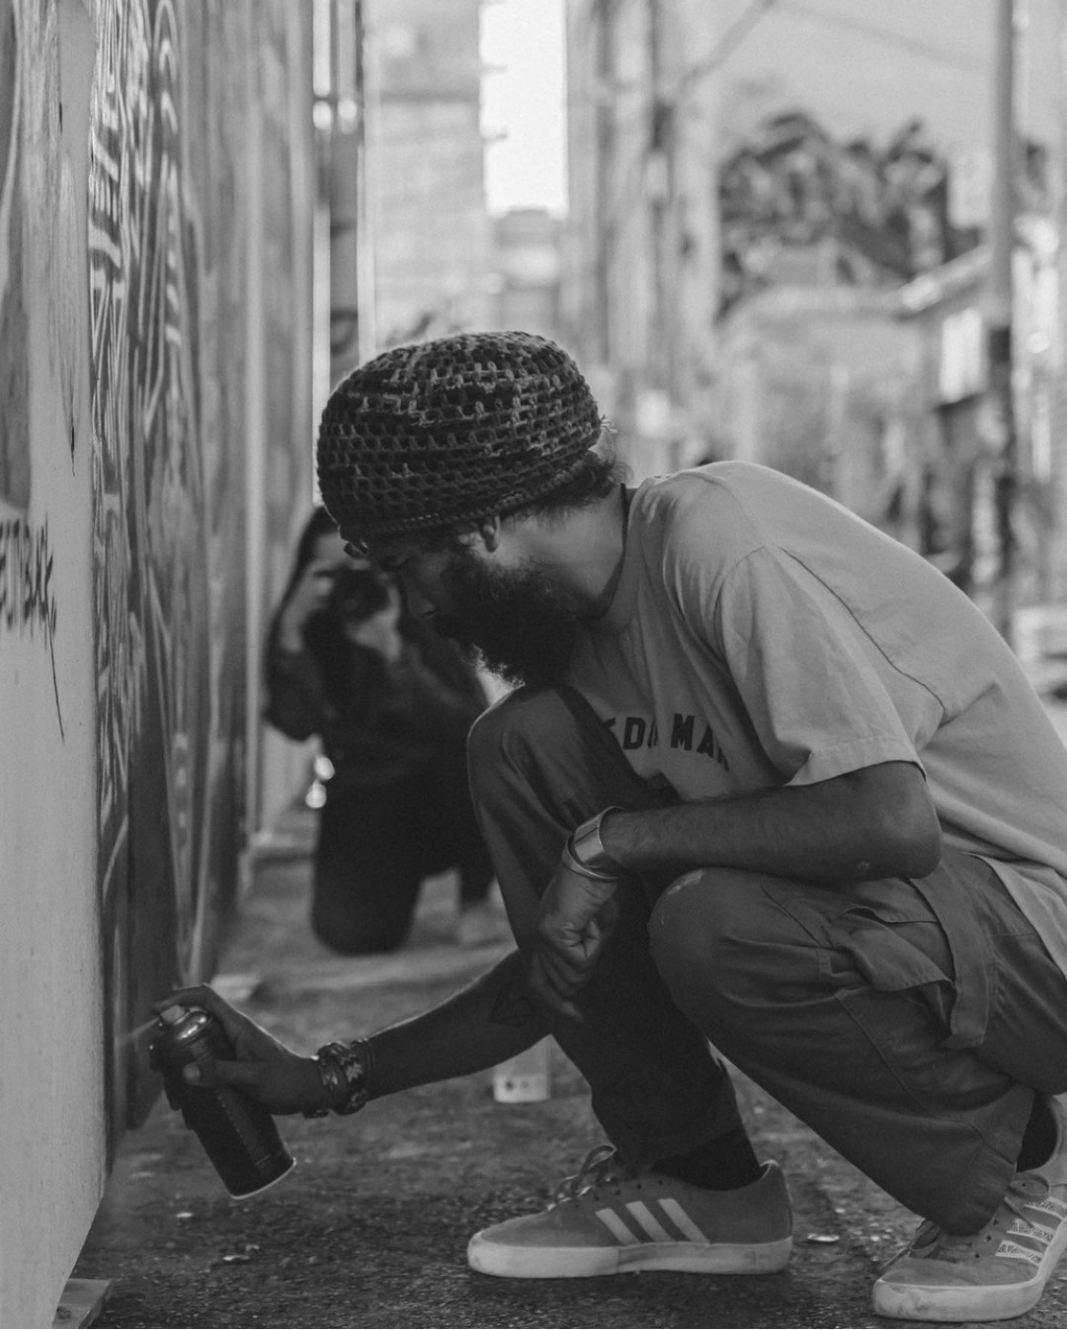
Art is not what you see, but what you make others to see- Edgar Degas

Slide 5
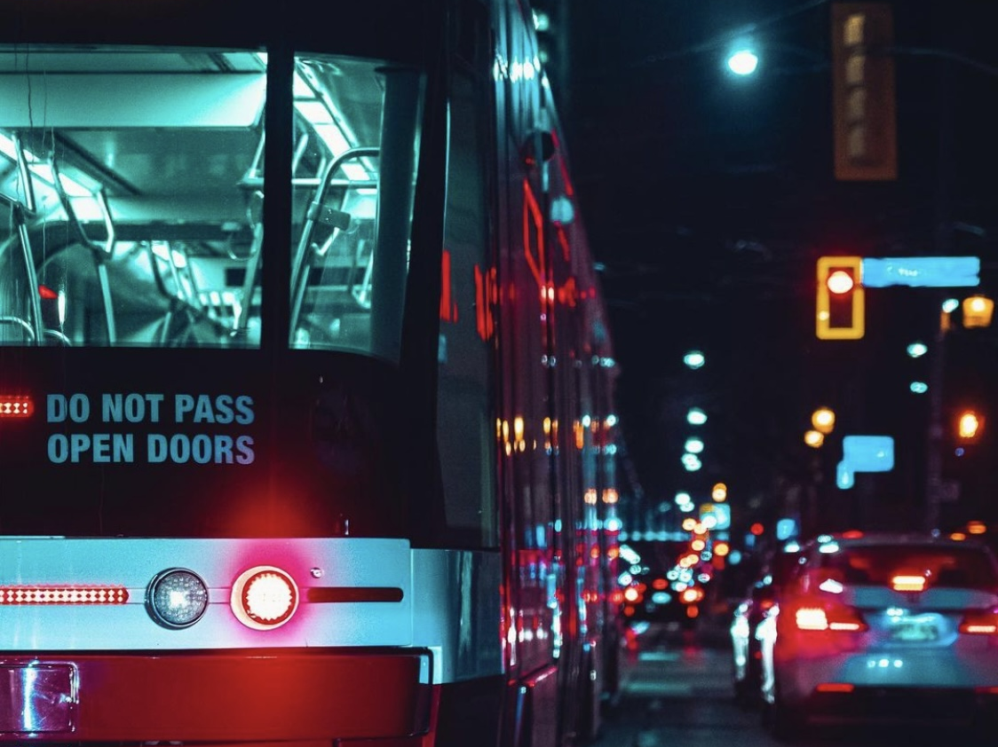
Picture Quick Styles give you great looking “frames” in a single click.

Slide 6
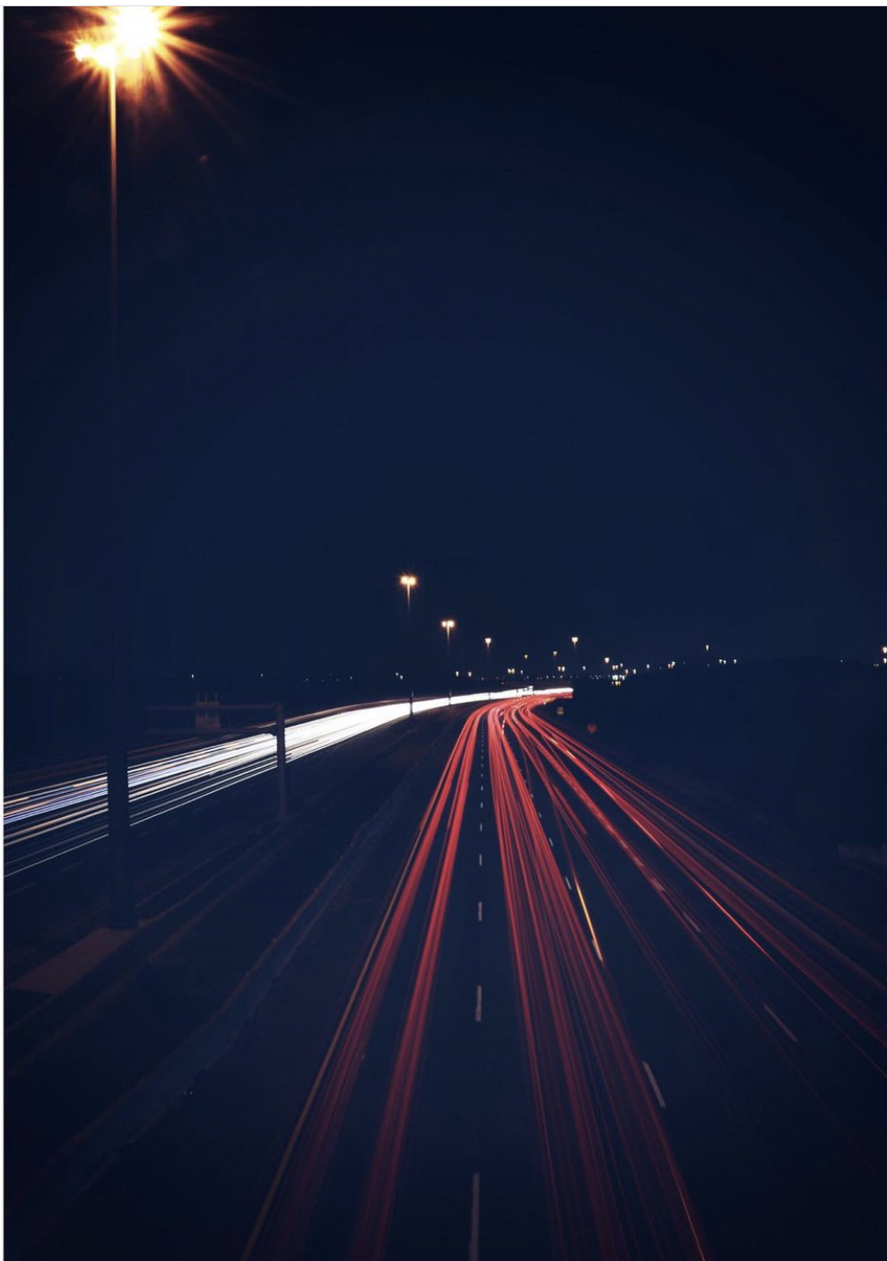
A long exposure creates a form that never existed.

Slide 7
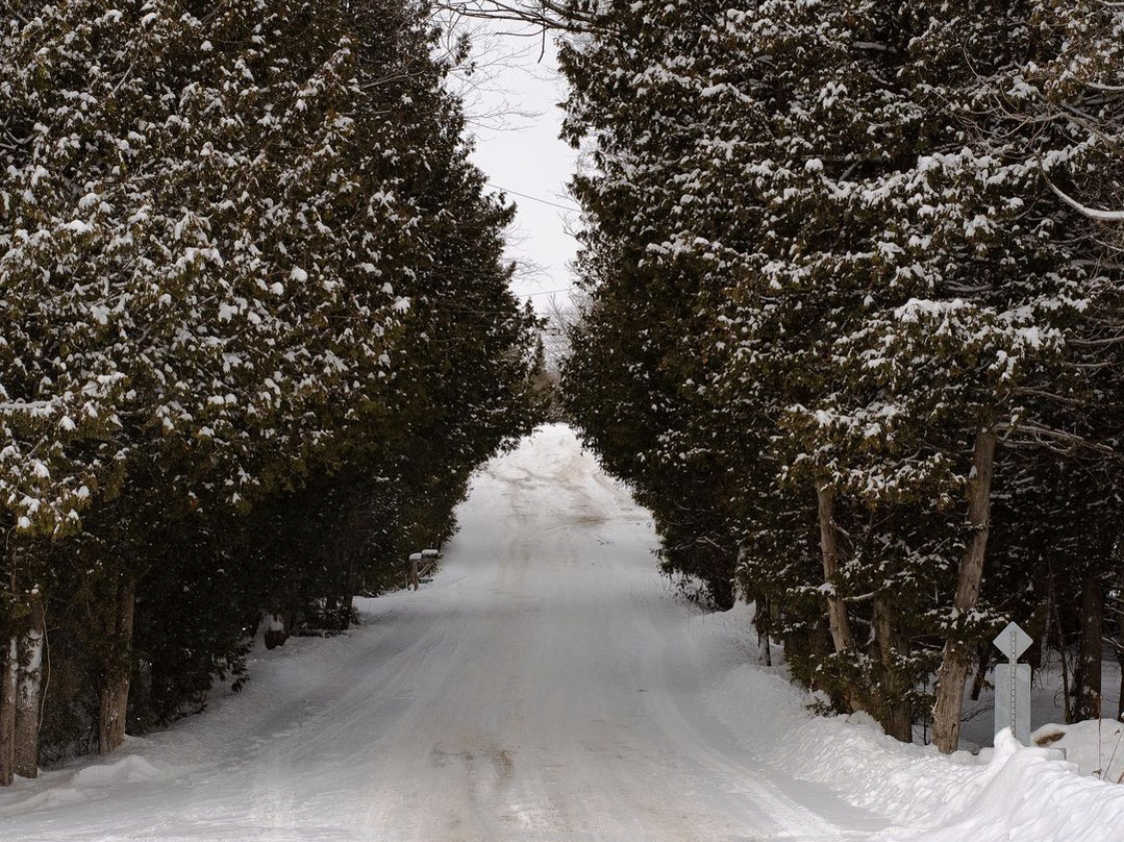

Slide 8
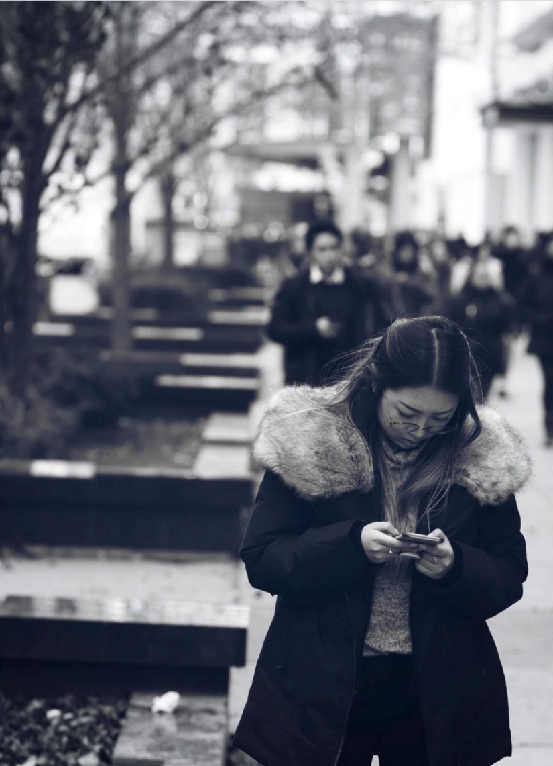
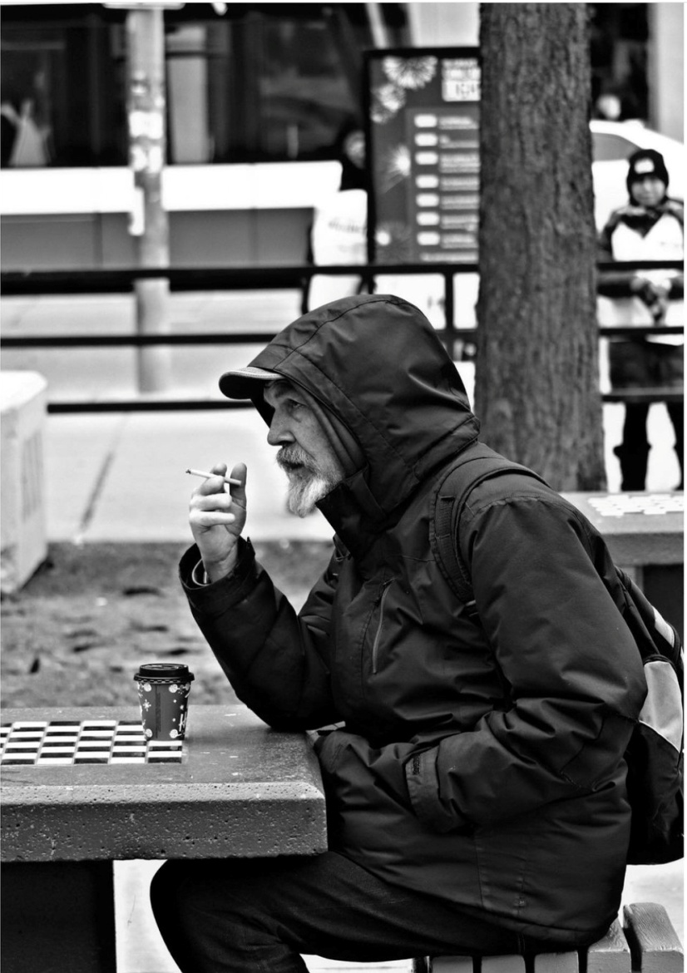
Feel the moment and snapped it.

Slide 9
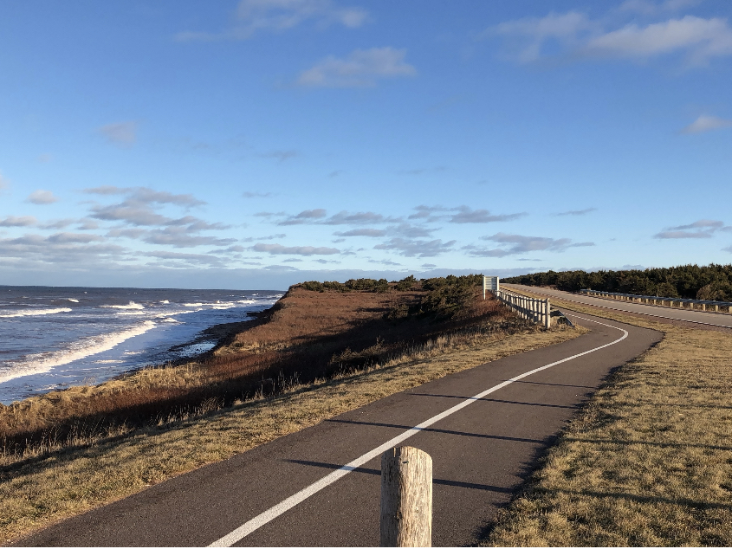

Slide 10
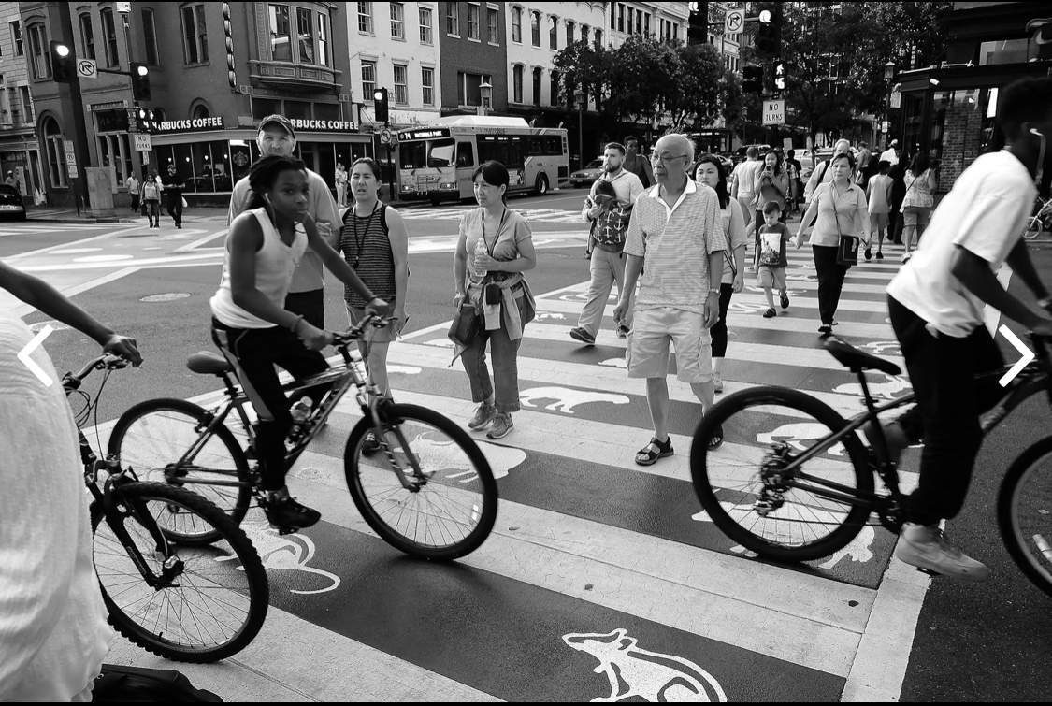
Capturing life in the street of Washington

Slide 11
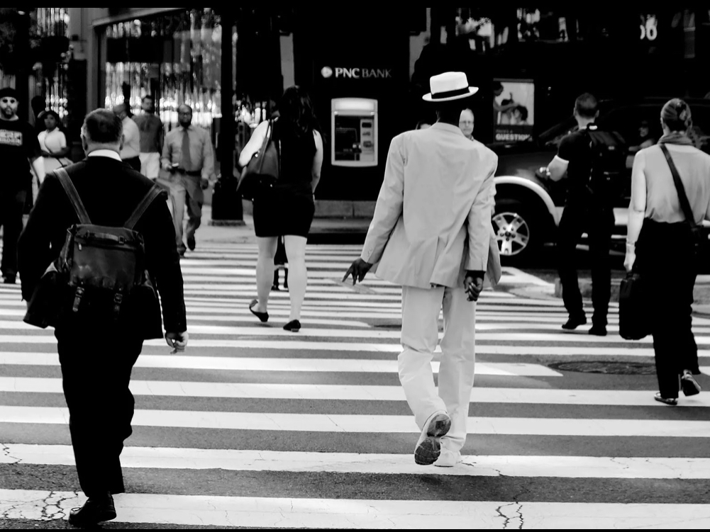

Slide 12
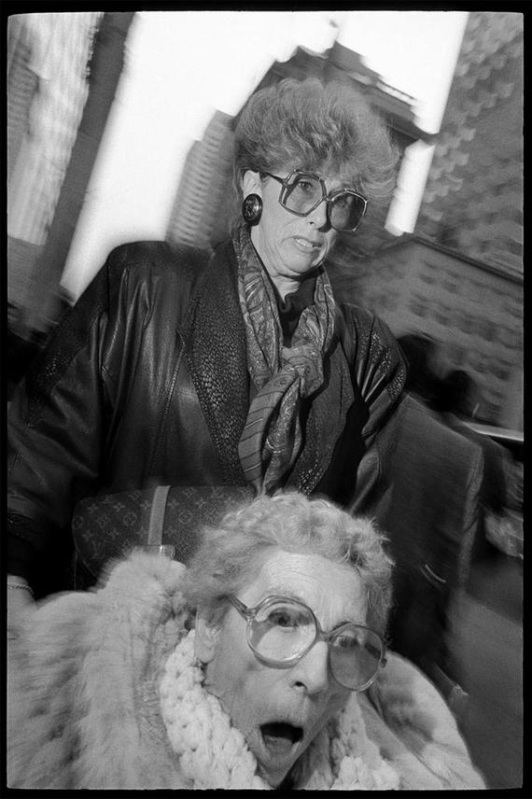
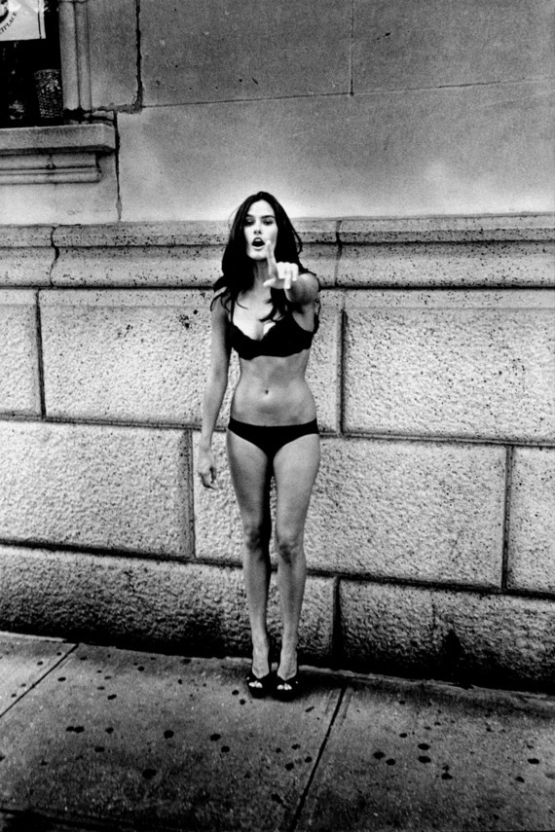

Slide 13
References
LensCulture, S. (2001). Street Photography as Process - Essay by Serge J-F. Levy. Retrieved December 09, 2020, from https://www.lensculture.com/articles/serge-j-f-levy-street-photography-as-process
Miller, R. (2018, October 04). How a wife's gift inspired this photographer to capture life in the streets of Washington. Retrieved December 09, 2020, from https://www.washingtonpost.com/graphics/2018/lifestyle/magazine/amp-stories/capturing-washington-city-life-through-street-photography/
Singh, B. (2018, April). Street life and lights [Digital image]. Retrieved 2020, from https://instagram.com/billz_photography?igshid=4ogcl8anwnj7

